Slide 1
Test Scenarios & Test Cases Where to start?
The Loan Application Example
INFO6255 2019

Slide 2
Where to start?
Read the Business Requirements (BRD)
Read and analyze the Functional Requirements (FRD)
Write the Test Plan/Test Strategy document
Create the Test Condition Matrix and come up with the test permutations
Perform the Equivalence Class Partitioning to reduce the test permutations
Create the test scenarios and link them to the Functional Requirements
Create the test cases with the test steps/expected results and actual results
Create the Traceability Matrix

Slide 3
Example of BRD/FSD/Test Condition Matrix
The Loan Application
The Business: Delivered the Business Requirements
The BSA in IT: Completed the Functional Requirements (Requirements or the Use Cases)
QA: Created the Master Test Plan/Test Strategy document
QA: Created the Test Condition Matrix
QA: Created the Test Scenarios and the Test Cases
QA and the BSA: Created the Traceability Matrix

Slide 4
The Loan Application
Apply For a Loan as a New User - The ‘New User’ Workflow
User REGISTERs
User Selects a Password
New User accesses the bank’s URL
User clicks on the APPLY LOAN button
User enters his/her Personal information
New User Successfully applies for a loan
User continue as a GUEST
User gets No Password Selection prompt

Slide 5
The Loan Application
Apply For a Loan as an Existing User
An ‘Existing User’ Workflow
“Sent for Review”
An Existing User accesses the bank’s URL
User Logs in with his/her user id
The User should see one of the loan statuses:
“Reviewed and Approved”
The user logs off
“Reviewed and Deleted”

Slide 6
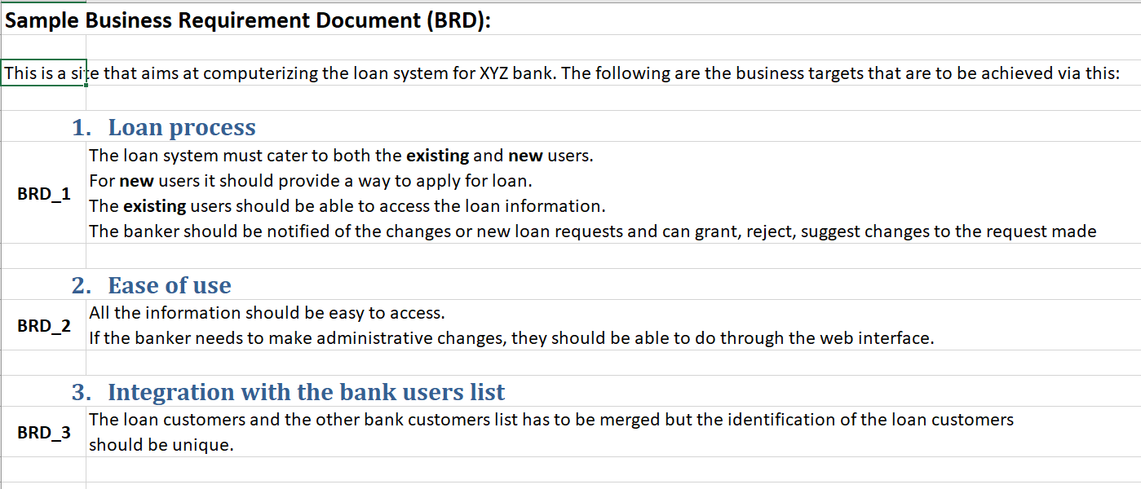

Slide 7
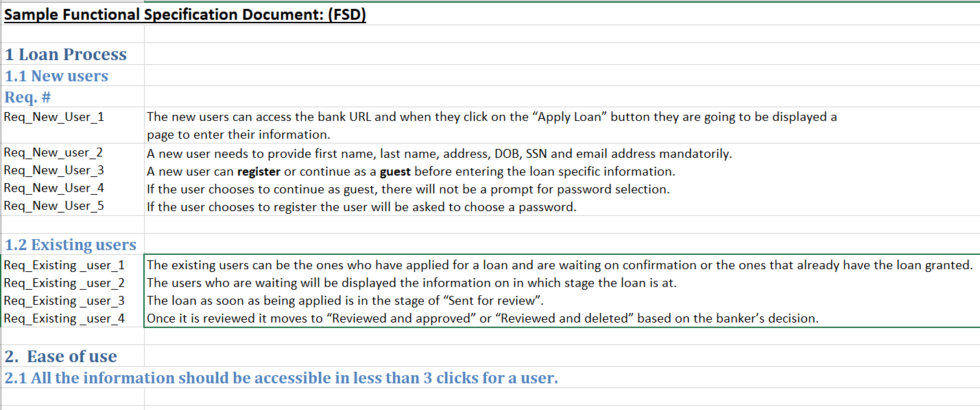

Slide 8
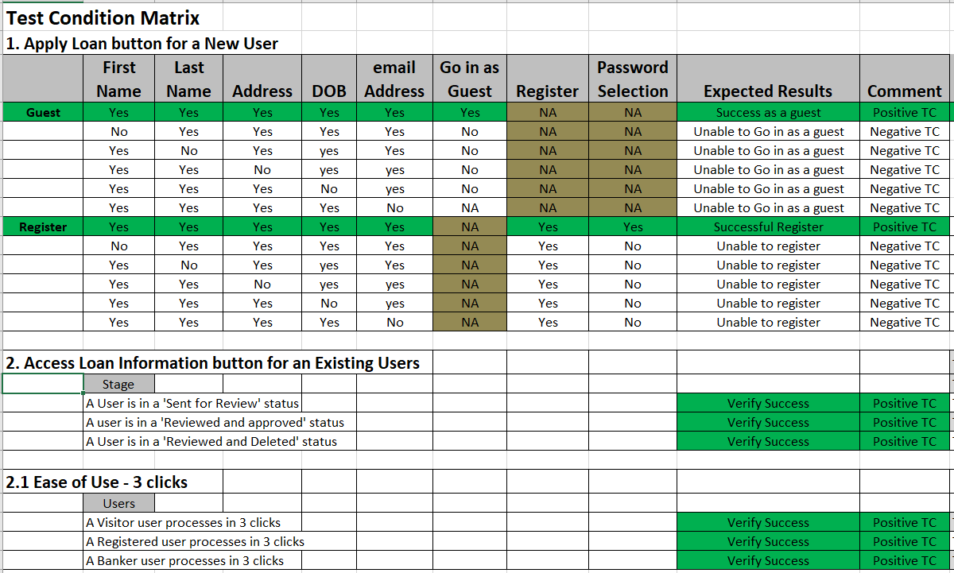

Slide 9
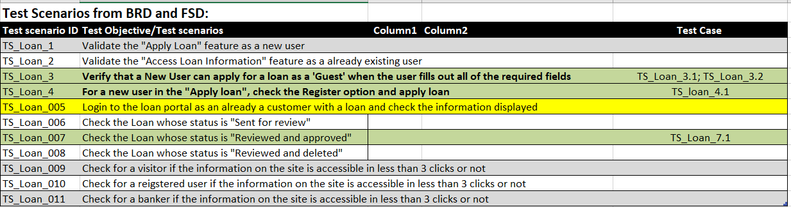
Test Scenarios

Slide 10
Test Cases
Test # | Test Case | Step # | Test Step | Expected Results | Actual Results | Status
TS_Loan_3.1 | Verify that a New User can apply for a loan as a 'Guest' when the user fills out all of the required fields |  |  | The user can continue to the loan process screen. There should be no prompts for password. | The user successfully continued to the loan process screen with no prompts for password | Pass
 |  | 1 | Go into the Loan Application as a new user. |  |  | Pass
 |  | 2 | Click on the Apply Loan button | The Register and Guest button appear | Guest Button appears | Pass
 |  | 3 | Click on the Guest User | The Guest User form appears | The Guest User form appeared | Pass
 |  | 4 | Fill out the following fields, First Name, Last Name, Address, DOB, eMail, and go in as a Guest user | The user Loan Screen appears | The Loan Screen appeared | Pass
 |  |  | Submit a New Loan for this Guest User | The loan successfully goes through | The loan submission was successful | Pass

Slide 11
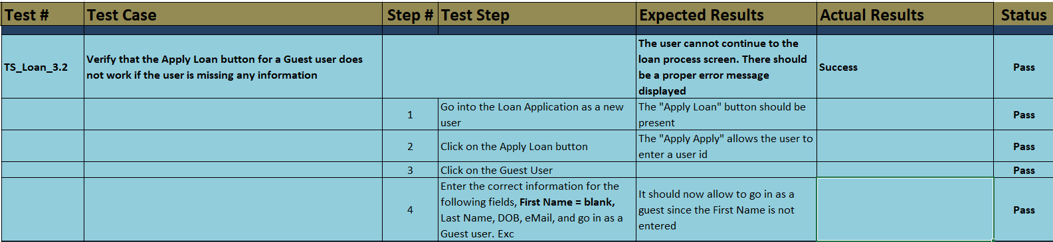
Test Cases

